Slide 1
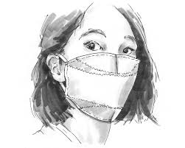
FACE MASK DETECTION USING DL
TEAM MEMBERS:
CHAITANYA(992)
PRANEETH(983)
VISHNU(995)
HARSHA(988)

Slide 2
PROBLEM STATEMENT:
The main objective of the face detection model is to detect the face of individuals and conclude whether they are wearing masks or not at that particular moment when they are captured in the image.

Slide 3
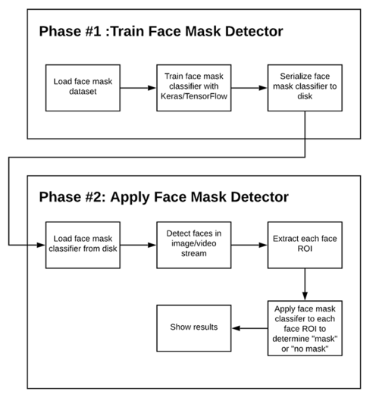
Two-phase's OF face mask detection

Slide 4
In order to train a custom face mask detector, we need to break our project into two distinct phases, each with its own respective sub-steps
Training: Here we’ll focus on loading our face mask detection dataset from disk, training a model (using Keras/TensorFlow) on this dataset, and then serializing the face mask detector to disk.
Deployment: Once the face mask detector is trained, we can then move on to loading the mask detector, performing face detection, and then classifying each face as WITH_MASK OR WITHOUT_MASK.

Slide 5
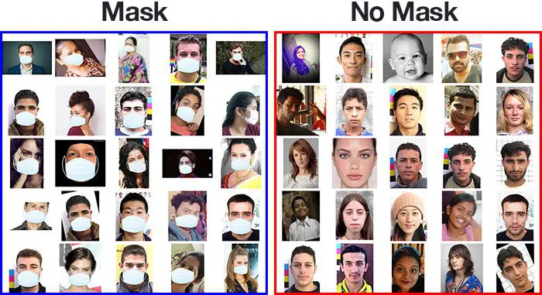
face mask detection dataset

Slide 6
How the dataset was created
Techniques used to create images:
Taking normal images of faces
Then creating a custom computer vision Python script to add face masks to them.
Facial landmarks allow us to automatically infer the location of facial structures, including:
Eyes, Eyebrows, Nose, Mouth, Jawline.
Steps:
Start with an image of person without mask
Apply face detection to compute the bounding box location of face.
Extract face Region of Interest (ROI)
Get image of a mask, and align it on top of the face properly.
Repeat the steps for multiple images

Slide 7
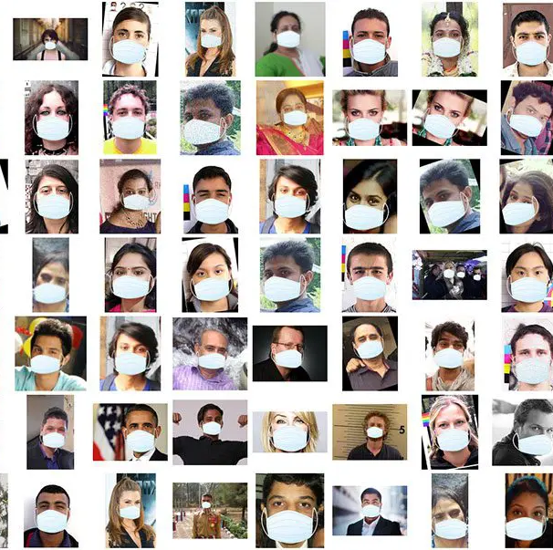
Artificial Face Mask Dataset

Slide 8
THANK YOU

